Slide 1
Chapter 1:
Introduction to Project Management
: Understanding motivations and concepts

Slide 2
Learning Objectives
Understand the growing need for better project management, especially for information technology projects
Explain what a project is and provide examples of information technology projects
Describe what project management is and discuss key elements of the project management framework

Slide 3
Learning Objectives
Discuss how project management relates to other disciplines
Understand the history of project management
Describe the project management profession, including recent trends in project management research, certification, and software products

Slide 4
Project Management Statistics
The U.S. spends $2.3 trillion on projects every year, an amount equal to one-quarter of the nation’s gross domestic product.
The world as a whole spends nearly $10 trillion of its $40.7 trillion gross product on projects of all kinds.
More than sixteen million people regard project management as their profession; on average, a project manager earns more than $82,000 per year.

Slide 5
More Information on Project Management
More than half a million new information technology (IT) application development projects were initiated during 2001, up from 300,000 in 2000.
Famous business authors and consultants are stressing the importance of project management. As Tom Peters writes in his book, Reinventing Work: the Project 50, “To win today you must master the art of the project!”

Slide 6
Motivation for Studying Information Technology (IT) Project Management
IT projects have a terrible track record
  A 1995 Standish Group study (CHAOS) found that only 16.2% of IT projects were successful and over 31% were canceled before completion, costing over $81 B in the U.S. alone
The need for IT projects keeps increasing
  In 2000, there were 300,000 new IT projects
  In 2001, over 500,000 new IT projects were started

Slide 7
Advantages of Using Formal Project Management
Better control of financial, physical, and human resources
Improved customer relations
Shorter development times
Lower costs
Higher quality and increased reliability
Higher profit margins
Improved productivity
Better internal coordination
Higher worker morale

Slide 8
What Is a Project?
A project is “a temporary endeavor undertaken to accomplish a unique product or service” (PMBOK® Guide 2000, p. 4)
Attributes of projects
  unique purpose
  temporary
  require resources, often from various areas
  should have a primary sponsor and/or customer
  involve uncertainty

Slide 9
Samples of IT Projects
Northwest Airlines developed a new reservation system called ResNet (see case study on companion Web site at www.course.com/mis/schwalbe)
Many organizations upgrade hardware, software, and networks via projects
Organizations develop new software or enhance existing systems to perform many business functions
Note: “IT projects” refers to projects involving hardware, software, and networks

Slide 10
The Triple Constraint
Every project is constrained in different ways by its
  Scope goals: What is the project trying to accomplish?
  Time goals: How long should it take to complete?
  Cost goals: What should it cost?
It is the project manager’s duty to balance these three often competing goals

Slide 11
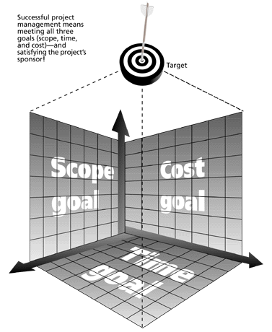
Figure 1-1. The Triple Constraint of Project Management

Slide 12
The 2001 Standish Group Report Showed Decided Improvement in Project Success
Time overruns significantly decreased to 163% compared to 222%
Cost overruns were down to 145% compared to 189%
Required features and functions were up to 67% compared to 61%
78,000 U.S. projects were successful compared to 28,000
28% of IT projects succeeded compared to 16%

Slide 13
Why the Improvements?
"The reasons for the increase in successful projects vary. First, the average cost of a project has been more than cut in half. Better tools have been created to monitor and control progress and better skilled project managers with better management processes are being used. The fact that there are processes is significant in itself.“*

Slide 14
What is Project Management?
Project management is “the application of knowledge, skills, tools, and techniques to project activities in order to meet project requirements”

Slide 15
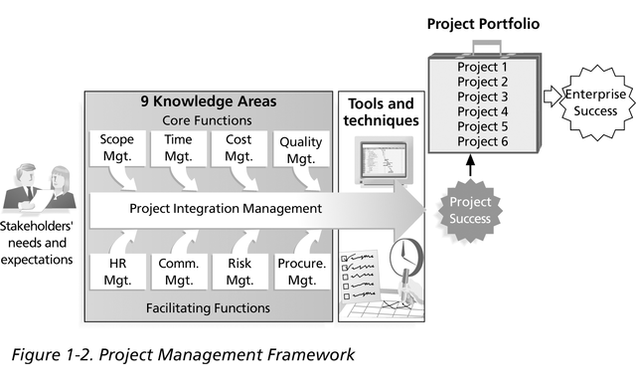
Figure 1-2. Project Management Framework

Slide 16
Project Stakeholders
Stakeholders are the people involved in or affected by project activities
Stakeholders include
  the project sponsor and project team
  support staff
  customers
  users
  suppliers
  opponents to the project

Slide 17
9 Project Management Knowledge Areas
Knowledge areas describe the key competencies that project managers must develop
  4 core knowledge areas lead to specific project objectives (scope, time, cost, and quality)
  4 facilitating knowledge areas are the means through which the project objectives are achieved (human resources, communication, risk, and procurement management)
  1 knowledge area (project integration management) affects and is affected by all of the other knowledge areas

Slide 18
Project Management Tools and Techniques
Project management tools and techniques assist project managers and their teams in various aspects of project management
Some specific ones include
  Project Charter, scope statement, and WBS (scope)
  Gantt charts, network diagrams, critical path analysis, critical chain scheduling (time)
  Cost estimates and earned value management (cost)

Slide 19
How Project Management Relates to Other Disciplines
Much of the knowledge needed to manage projects is unique to the discipline of project management
Project mangers must also have knowledge and experience in
  general management
  the application area of the project

Slide 20
History of Project Management
Some people argue that building the Egyptian pyramids was a project, as was building the Great Wall of China
Most people consider the Manhattan Project to be the first project to use “modern” project management
  This three-year, $2 billion (in 1946 dollars) project had a separate project manager and a technical manager

Slide 21
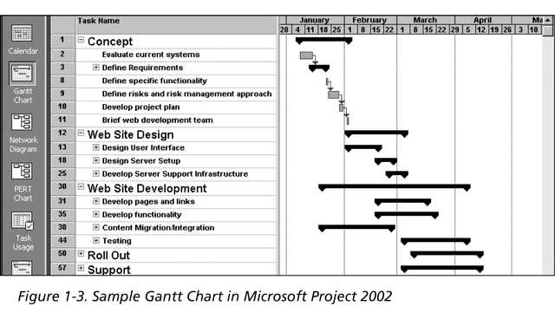
Sample Gantt Chart
The WBS is on the left, and each task’s start and finish date
are shown on the right using a calendar timescale. Early Gantt
Charts, first used in 1917, were drawn by hand.

Slide 22
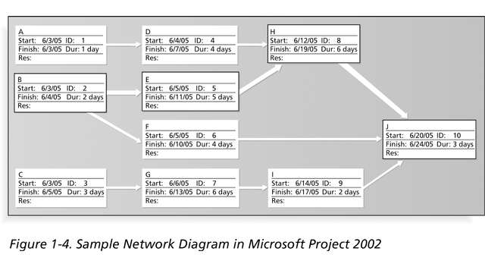
Sample Network Diagram
Each box is a project task from the WBS. Arrows show dependencies
between tasks. The bolded tasks are on the critical path. If any tasks on the
critical path take longer than planned, the whole project will slip
unless something is done. Network diagrams were first used in 1958 on the Navy Polaris project, before project management software was available.

Slide 23
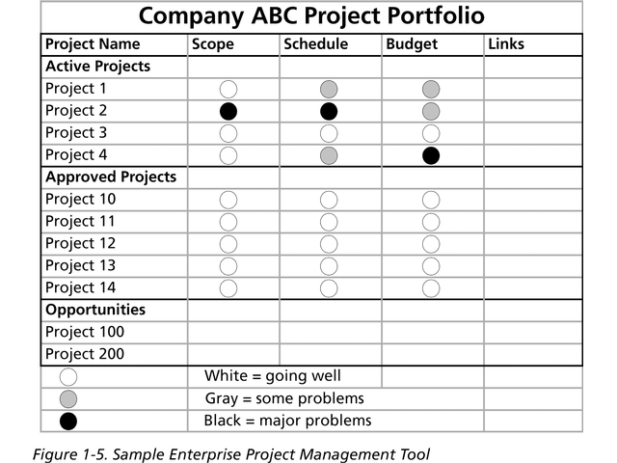
Sample Enterprise Project Management Tool
In recent years, organizations have been taking advantage of software
to help manage their projects throughout the enterprise.

Slide 24
The Project Management Profession
The job of IT Project Manager is in the list of the top ten most in demand IT skills
Professional societies like the Project Management Institute (PMI) have grown tremendously
Project management research and certification programs continue to grow

Slide 25
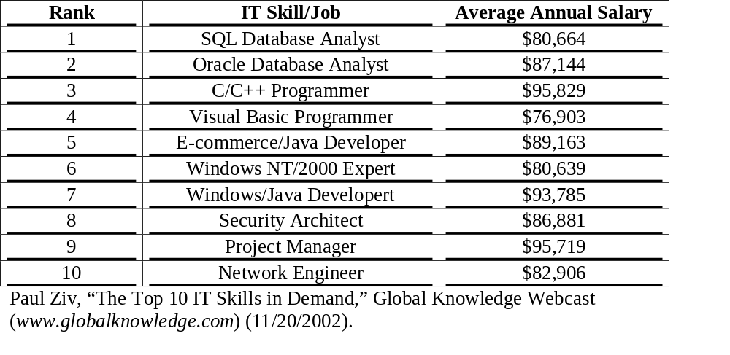
Table 1-2. Top Ten Most in Demand IT Skills

Slide 26
Project Management Knowledge Continues to Grow and Mature
PMI hosted their first research conference in June 2000 in Paris, France, and the second one in Seattle in July 2002
The PMBOK® Guide 2000 is an ANSI standard
PMI’s certification department earned ISO 9000 certification
Hundreds of new books, articles, and presentations related to project management have been written in recent years

Slide 27
Project Management Certification
PMI provides certification as a Project Management Professional (PMP)
A PMP has documented sufficient project experience, agreed to follow a code of ethics, and passed the PMP exam
The number of people earning PMP certification is increasing quickly
PMI and other organizations are offering new certification programs

Slide 28
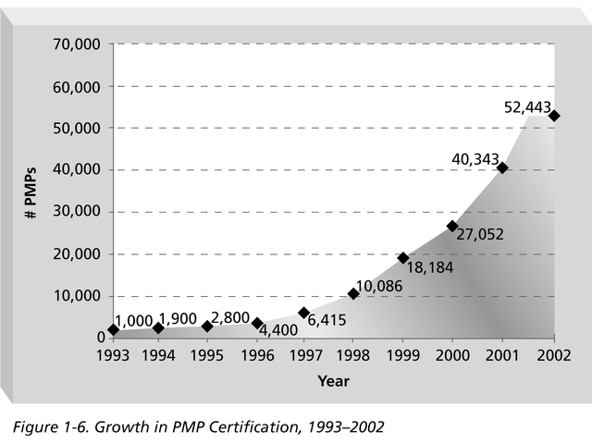
Growth in PMP Certification, 1993-2002

Slide 29
Ethics in Project Management
Ethics is an important part of all professions
Project managers often face ethical dilemmas
In order to earn PMP certification, applicants must agree to the PMP code of professional conduct

Slide 30
You Can Apply Project Management to Many Areas
Project management applies to work as well as personal projects
Project management applies to many different disciplines (IT, construction, finance, sports, event planning, etc.)
Project management skills can help in everyday life

Slide 31
Thank you

